Slide 1
Service Management in Quantum Cloud Computing: Current Trends, Challenges, and Future Directions.
Yash Sanjaybhai Jadav - 200519386
Jay Bharatbhai Panchal - 200518664
Week 5
November 28, 2024
Cloud Computing and Applications (ENSE-885BD)

Slide 2
Agenda
Introduction
Goal of the study
Research Methodology
Research Methodology Outcomes
Taxonomy and State of the Art
Conclusion and Future Research Directions
References

Slide 3
Introduction
Quantum Cloud Computing (QCC) combines quantum computing with cloud platforms to make quantum resources accessible without needing physical quantum hardware. This integration is crucial for addressing problems in cryptography, optimization, and simulations that classical systems struggle with. Service management in QCC encompasses the orchestration, provisioning, and optimization of quantum resources to deliver seamless, scalable, and efficient quantum computing services to users worldwide.
Service management in Quantum Cloud Computing is a critical area that ensures the efficient, reliable, and secure delivery of quantum computing services to users. This encompasses the orchestration of quantum resources, optimization of computational tasks, and seamless integration of quantum and classical computing environments. As the field evolves, so do the complexities and challenges associated with managing these sophisticated quantum services.

Slide 4
Goal of the Study
Understand Service Management Dynamics in Quantum Cloud Computing
To analyze how service management principles are applied in quantum cloud environments, including resource allocation, workload distribution, and service orchestration.
Identify Current Trends
To explore emerging trends in quantum cloud computing, such as serverless computing (QFaaS), hybrid quantum-classical models, and quantum edge integration.
Address Key Challenges
To investigate and propose solutions for challenges in service management, including scalability, interoperability, error mitigation, and cost efficiency in quantum cloud services.
Optimize User Experience
To study user requirements for quantum cloud services and design service management strategies that enhance accessibility, performance, and reliability.
Standardize Quantum Cloud Service Frameworks
To propose standardized frameworks and best practices for managing quantum services, ensuring consistency and quality across various platforms.

Slide 5
Research Methodology
Search Strings and Keywords
("Service Management" OR "Service Reliability") AND ("Quantum Cloud Computing" OR QCC)
("Quantum Cloud Computing" OR "Quantum Cloud Providers") AND ("Service Management" OR "Resource Management" OR "Service Oriented Computing")
("Quantum Resource Management" OR "Quantum Service Management") AND ("Service Availability" OR "Service Reliability" OR "Fault Management" OR "Fault Tolerance") AND ("Quantum Cloud" OR "Cloud Computing")
("Quantum Computing" OR "Quantum bit Computing") AND ("Resource Management" OR "Fault Tolerance" OR "Resource Availability") AND ("Cloud Computing" OR "Quantum Cloud Platforms")

Slide 6
Research Methodology
Review Methodology or Data Synthesis
This section outlines the systematic approach employed to review existing literature and synthesize data for our research on "Service Management in Quantum Cloud Computing: Current Trends, Challenges, and Future Directions.“
Literature Search Strategy
To ensure a comprehensive understanding of the subject, we conducted a systematic literature review using the following digital research libraries:
Google Scholar
IEEE Xplore
ACM Digital Library
SpringerLink
ScienceDirect

Slide 7
Inclusion and Exclusion Criteria
Applying clear criteria ensured the selection of high-quality and pertinent literature.
Inclusion Criteria
Publication Date: Studies published between November 2020 and November 2024.
Language: Publications available in English.
Peer-Reviewed: Articles from peer-reviewed journals or reputable conferences.
Relevance: Works focusing on service management aspects within quantum cloud computing, including resource management, security, scalability, interoperability, and user experience.

Slide 8
Exclusion Criteria
Irrelevance: Papers not addressing cloud service aspects of quantum computing.
Non-Peer-Reviewed Sources: Excluded opinion pieces, editorials, and non-scientific articles.
Duplication: Removed duplicate studies or superseded versions.
Accessibility: Excluded works without full-text availability.

Slide 9
Data Synthesis
Define search key words
Search existing Research work using search key words
Exclusion based on Titles
Exclusion based on Abstract and Conclusion
Exclusion based on full text
Outline the Findings
Exclusion based on common Objections and References

Slide 10
Research Methodology
Research Questions
What are the trends and advancements in QCC?
What challenges exist in resource allocation and error correction?
How can service reliability and fault tolerance be enhanced in quantum cloud computing environments?
What role do quantum cloud providers play in optimizing service delivery and ensuring resource efficiency in quantum cloud platforms?

Slide 11
Research Methodology Outcomes
Number of Papers Reviewed: 100
Papers Meeting Inclusion Criteria: 48
Key Focus Areas Identified:
Resource Allocation and Scheduling: 35%
Security and Privacy: 25%
Scalability Issues: 20%
Interoperability: 10%
User Access and Interfaces: 10%

Slide 13
Taxonomy and State of the Art
Resource Management
Allocation and scheduling of quantum resources.
Security and Privacy
Ensuring secure transmission and computation.
Scalability
Handling increasing demand and resource limitations.
Interoperability
Integration with classical systems and other quantum platforms.
User Experience
Accessible interfaces and programming models.

Slide 14
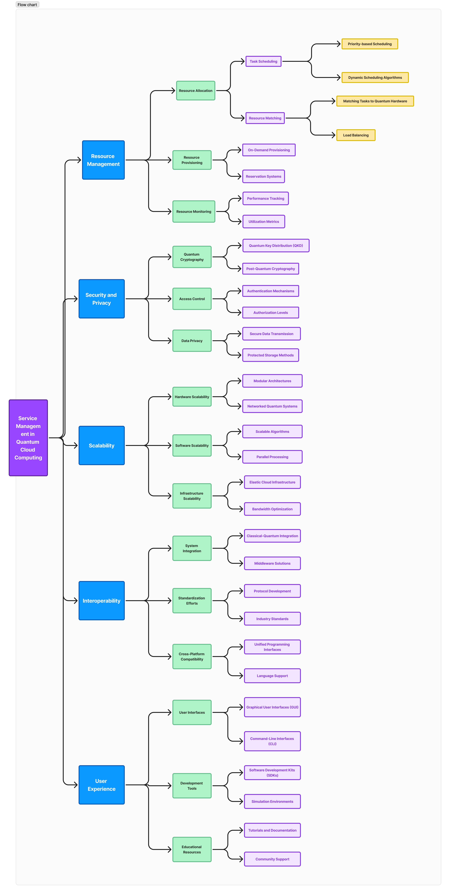

Slide 15
Taxonomy and State of the Art
1. Golec et al., "Quantum Cloud Computing: Trends and Challenges“
What has been done
The study provides an extensive analysis of the integration of quantum and cloud computing technologies.
It highlights emerging trends such as the development of Quantum Artificial Intelligence (QAI) and the adoption of serverless computing models in the quantum domain.
The paper also explores the business implications of quantum cloud computing, emphasizing its potential to transform industries requiring high-performance computation.
Limitations:
Error correction challenges: The lack of robust mechanisms for handling quantum errors remains a significant barrier to the reliable use of quantum systems.
Qubit instability: Quantum bits are highly sensitive to environmental factors, leading to performance degradation and limiting their practical usability.
Future Directions:
Focus on developing quantum cryptography to ensure secure communication in quantum cloud environments.
Improve qubit stability by leveraging advanced hardware techniques and integrating error-resilient algorithms.

Slide 16
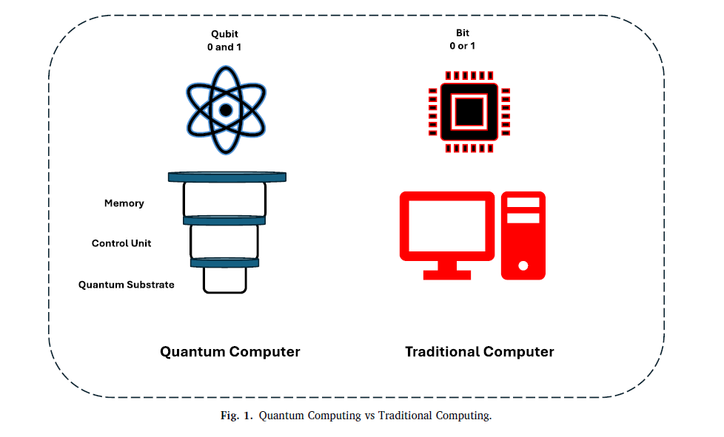
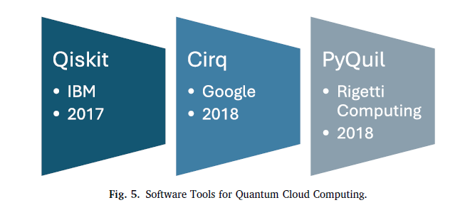
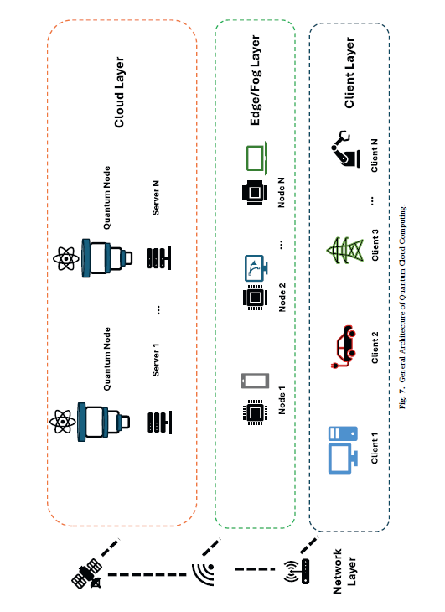

Slide 17
2. Nguyen et al.,
"Quantum Cloud Computing: A Review, Open Problems, and Future Directions“
What has been done
This review synthesizes recent advancements in quantum cloud computing (QCC), offering a comprehensive overview of state-of-the-art developments.
Key areas covered include resource management, quantum security, distributed computing techniques, and software frameworks.
The paper identifies gaps in current research and outlines challenges related to implementing scalable and secure quantum services.
Limitations:
Scalability: The limited availability of quantum hardware hinders the scalability of QCC systems, especially when dealing with large workloads.
Security vulnerabilities: Existing security frameworks for QCC are not robust enough to counteract evolving threats.
Future Directions:
Invest in fault-tolerant quantum computing to overcome limitations in current quantum hardware.
Explore the development of distributed quantum cloud systems to enhance scalability and operational efficiency.

Slide 18
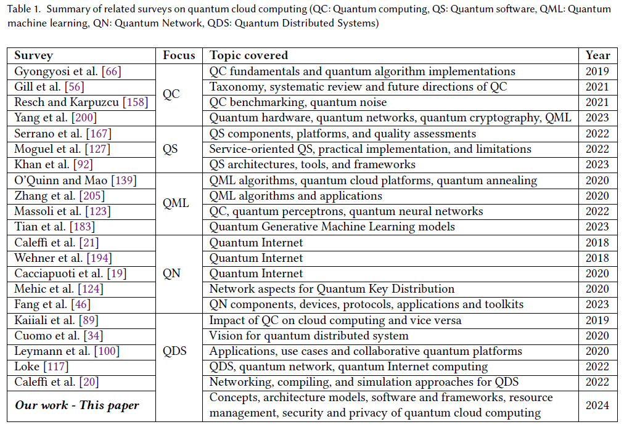

Slide 19
3. Mathew et al., "Quantum AI in Cloud Environments “
What has been done
Explores the integration of Quantum AI in cloud computing.
Key research areas include serverless quantum architecture, and quantum algorithms for AI.
Demonstrates applications in finance, healthcare, and supply chain management, highlighting computational speed and efficiency improvements.
Limitations:
Limited availability of skilled professionals in quantum computing.
High costs associated with quantum hardware and infrastructure.
Knowledge gaps in interdisciplinary applications.
Future Directions:
Addressing talent shortages through education and training.
Expanding quantum AI applications across other industries.
Enhancing cost-effectiveness and accessibility of quantum technologies.

Slide 20
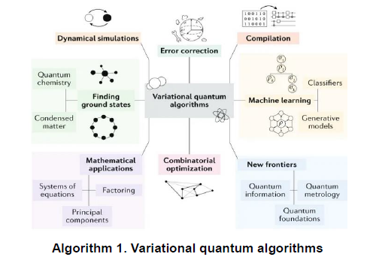
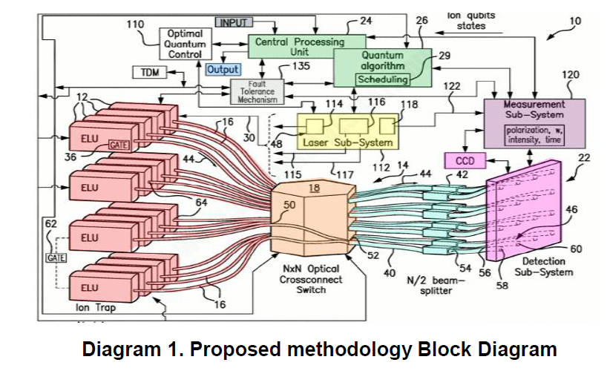

Slide 21
4. Rahaman et al.,"Progress and Problems of Quantum Computing as a Service (QCaaS)“,
What has been done
Reviews the potential of quantum computing to resolve weaknesses in cloud systems, such as security, processing inefficiencies, and data backup.
Discusses quantum cryptography to secure data transmission and blind quantum computing to protect against malicious providers.
Limitations:
Integration of classical and quantum systems is highly complex.
Quantum technologies are still experimental and lack robustness for widespread adoption.
Future Directions:
Integration of classical and quantum systems is highly complex.
Quantum technologies are still experimental and lack robustness for widespread adoption.

Slide 22
5. Rajawat et al. ,"Integration of Quantum Algorithms in Cloud Architectures“
What has been done
Investigates the application of Quantum Monte Carlo (QMC) and Quantum Machine Learning (QML) to address performance and scalability issues in cloud systems.
Demonstrates significant reductions in processing time and improved predictive accuracy using quantum algorithms.
Proposes a framework for quantum cloud computing to enable more scalable and resilient systems.
Limitations:
Limited testing in real-world scenarios; results are mostly theoretical or based on initial trials.
Lack of infrastructure to fully support quantum cloud computing on a large scale.
Future Directions:
Scaling quantum cloud computing frameworks for broader implementation.
Investigating more use cases to validate the performance improvements.

Slide 23
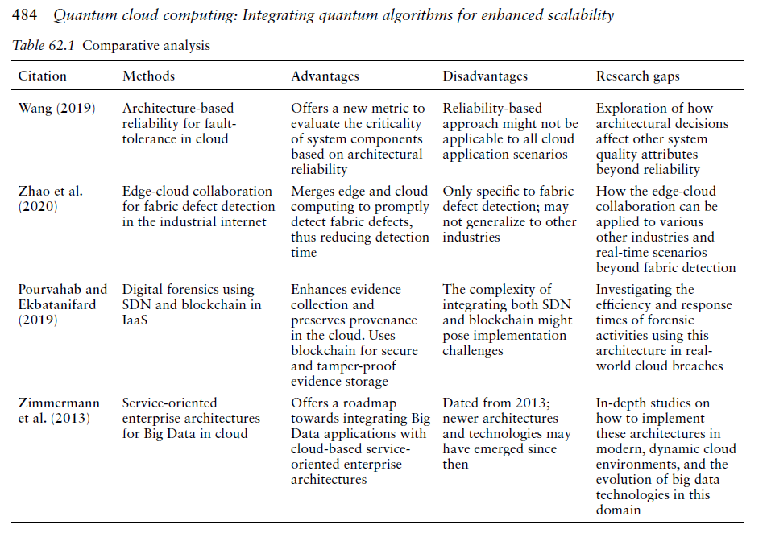

Slide 24
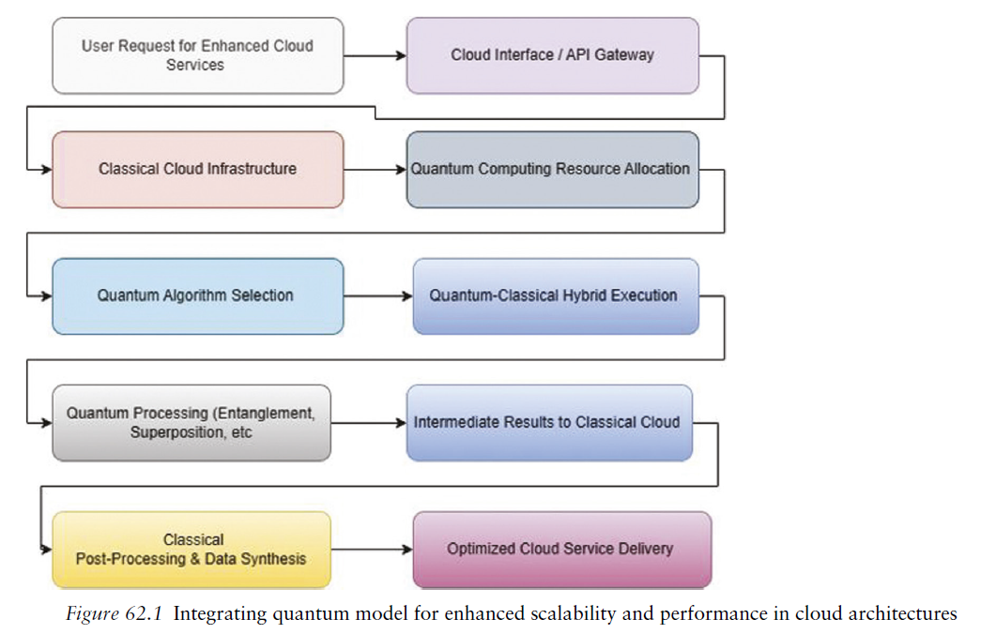

Slide 25
Conclusion and Future Research Directions
Conclusion:-
The state of the art in quantum cloud computing demonstrates significant progress in integrating quantum computing with cloud infrastructure. This integration has enabled access to quantum resources for research and industrial applications without requiring expensive quantum hardware. Advances in hybrid quantum-classical computing models, resource management frameworks, and serverless architectures have paved the way for improved scalability and efficiency. Despite these achievements, challenges such as limited scalability, error correction, and security vulnerabilities persist. Current implementations are constrained by the capabilities of quantum hardware and the lack of standardized software frameworks, which hinder widespread adoption.

Slide 26
Future Research Directions :-
Fault-Tolerant Quantum Systems
Scalability of Quantum Cloud Platforms
Standardization of Quantum Software Development
Enhanced Security and Privacy
Resource Optimization and Efficiency
Service-Level Agreements (SLAs)
Real-World Deployments and Use Cases

Slide 27
References
Golec, M., Hatay, E. S., & Uyar, M. (2024). Quantum Cloud Computing: Trends and Challenges.
Nguyen, H. T., Krishnan, P., & Krishnaswamy, D. (2024). Quantum Cloud Computing: A Review, Open Problems, and Future Directions.
Mathew, M., Johnson, T., & Kim, S. (2024). Quantum AI in Cloud Environments.
Rahaman, F., Ahmad, R., & Chaudhary, N. (2024). Progress and Problems of Quantum Computing as a Service (QCaaS).
Rajawat, S., Patel, J., & Desai, K. (2024). Integration of Quantum Algorithms in Cloud Architectures.

